Slide 1
Prosthetic Hand Control via Shoulder Movement
Nitay ozer
Itay mal
supervisor KobY Kohay

Slide 2

Problem Definition
Wirelessly controlling Haifa 3D robotic prosthetic hand
Using user’s shoulder movements

Slide 3

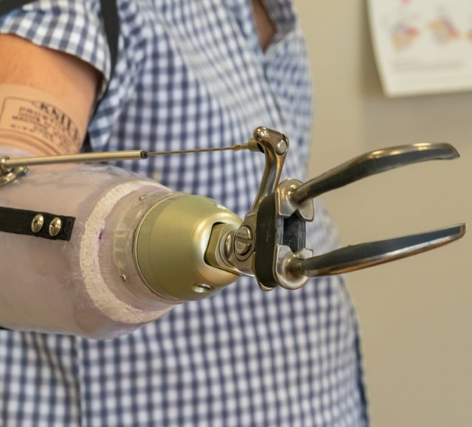
Existing solution- Mechanical Straps
Pros:
Simple
Reliable
Independent of power source
Cons:
Requires a lot of physical effort to operate
Limited in DOF
Unnatural look

Slide 4
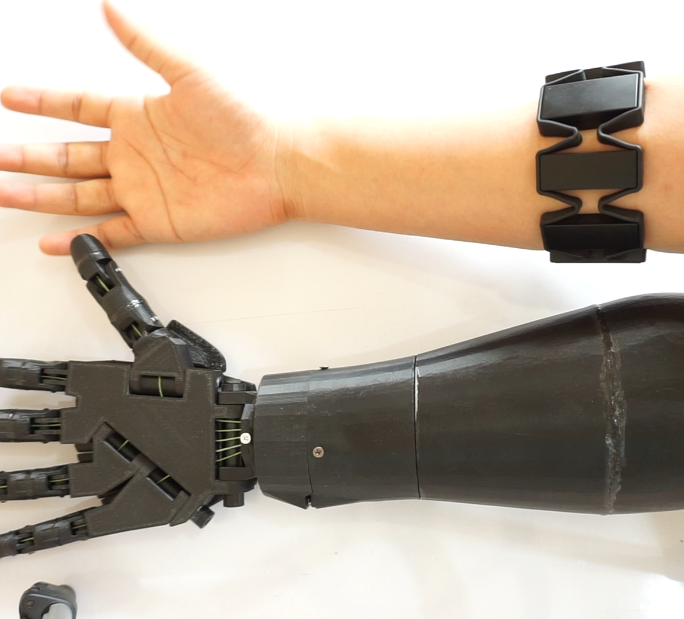
Existing solution- Myoelectric (EMG) Control
Pros:
High variety of DOF
Can look like natural arm
Intuitive operation*
Cons:
Expensive
Heavy
High power consumption
Phantom pain*

Slide 5
Possible Approaches

Slide 6
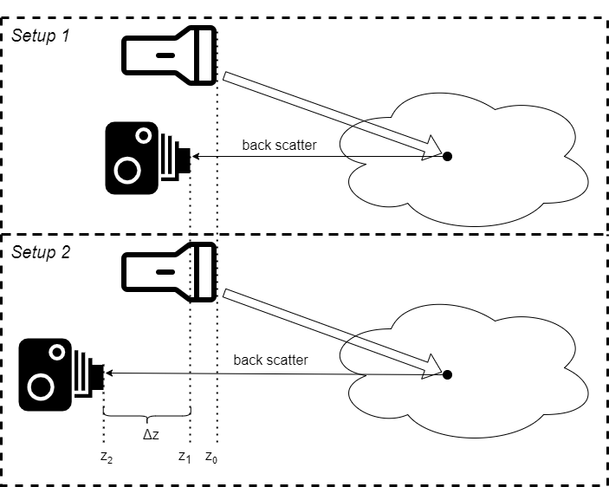

Beam Attenuation
Light source is fixed
Camera moved horizontally
Measuring difference in backscattered light
Main Disadvantage:
Requires external light to be negligible
Requires “clean” scene
$$c^{\left(k\right)}=−\frac{1}{Δz}\ln\left(\frac{{\left(I_{2}\right)}^{\left(k\right)}}{{\left(I_{1}\right)}^{\left(k\right)}}\right)$$

Slide 7
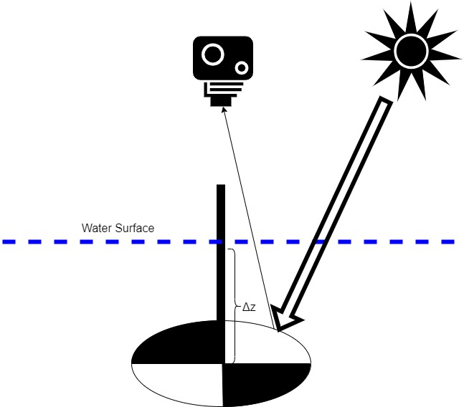

Secchi Disk
Disk is lowered vertically
Measures by disappearance depth
Main disadvantage:
Requires very deep water body
$$Δz=\frac{\ln\left(\frac{C_{0}}{C_{T}}\right)}{c+K}$$

Slide 8
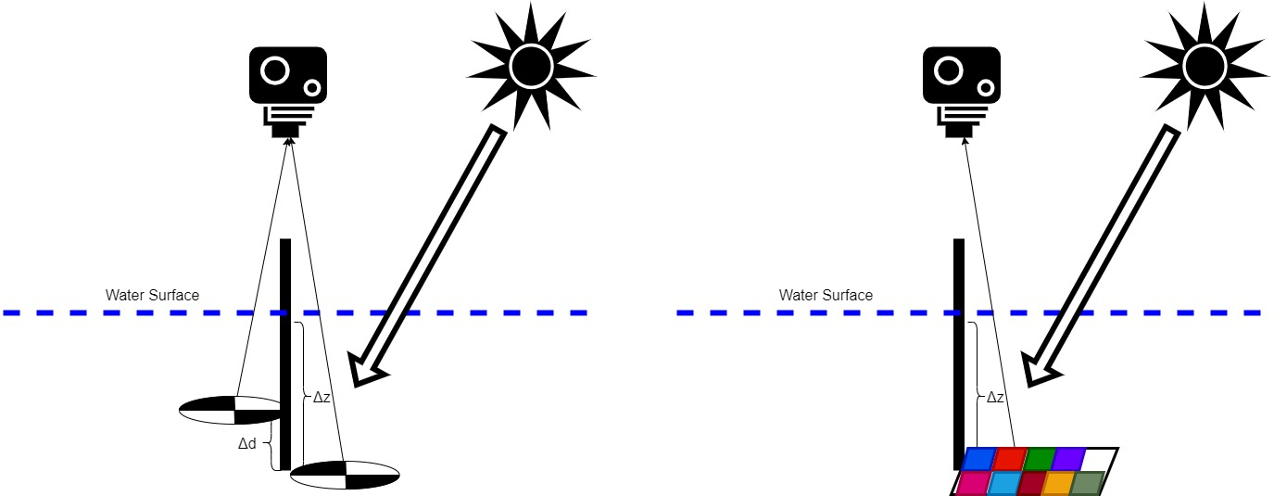
Secchi Disk Improvements
Two targets – reduce required depth
Use color table target – specific wavelength

Slide 9
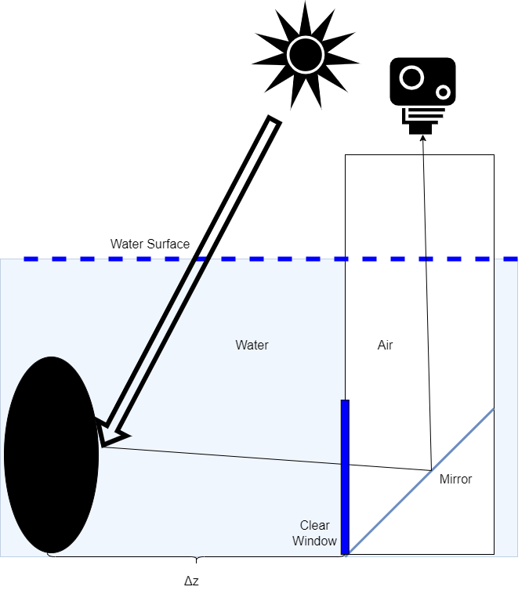

Black Disk
Move the disk horizontally
Based on the disappearance distance
Main disadvantage:
Requires very wide water body
Additional complexity due to viewing apparatus
$$Δz=\frac{\ln\left(−\frac{1}{C_{T}}\right)}{c}$$

Slide 10
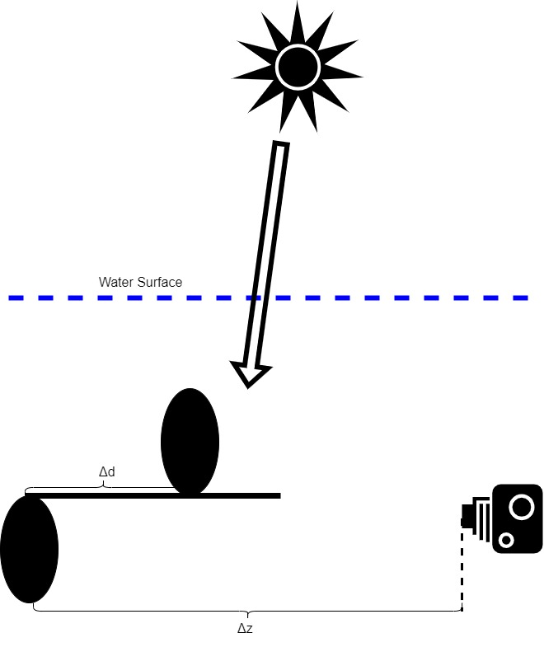
Black Disk Improvements
Take photo underwater – reduce complexity and reflection effect
Two targets – reduce required distance

Slide 11
Purposed Solution

Slide 12
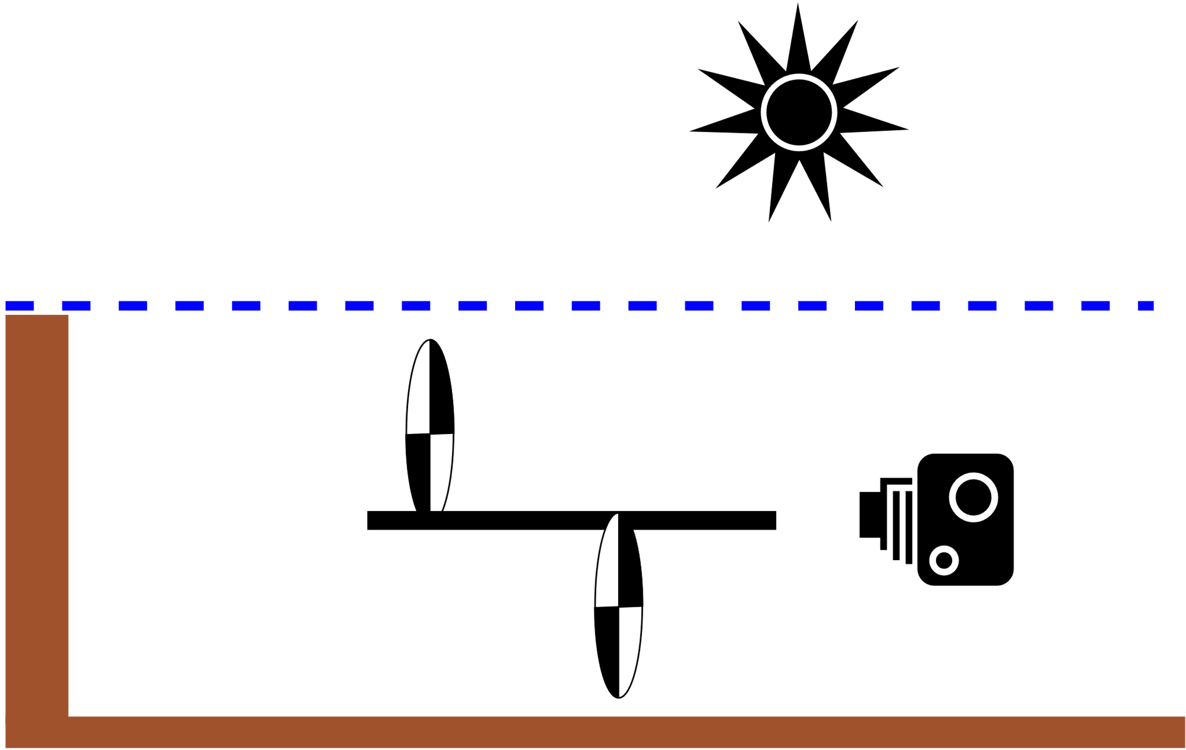
Basic Assumptions
Water body dimension fit to measuring device
Turbidity conditions that fit for optical measurement
Daylight/mobile phone flashlight
Consistency of water turbidity in water body

Slide 13

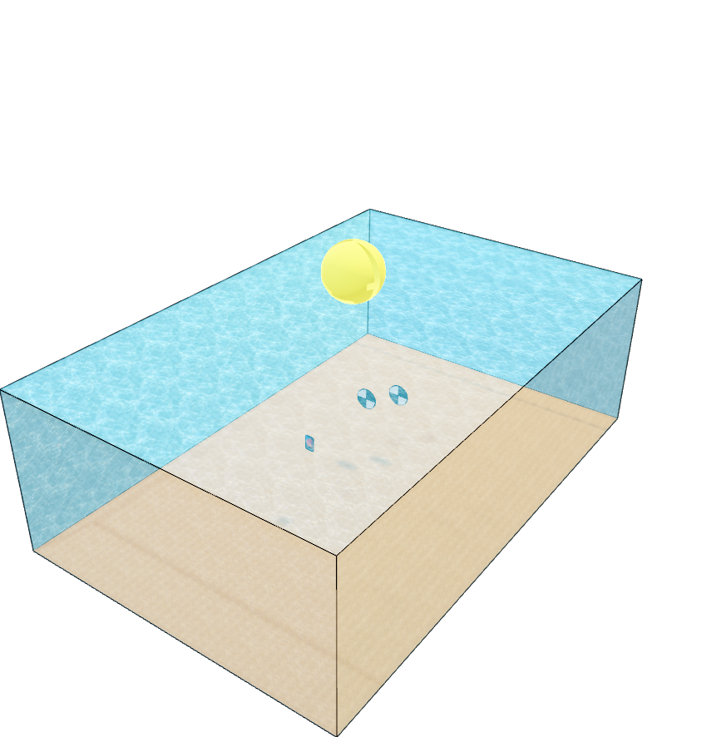
Measurement Setup

Slide 14
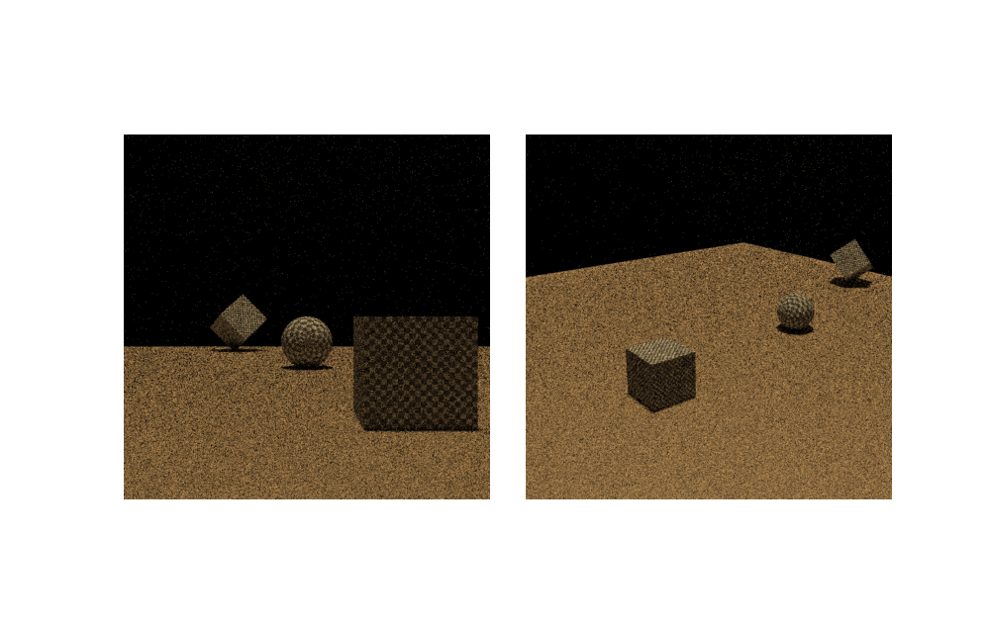
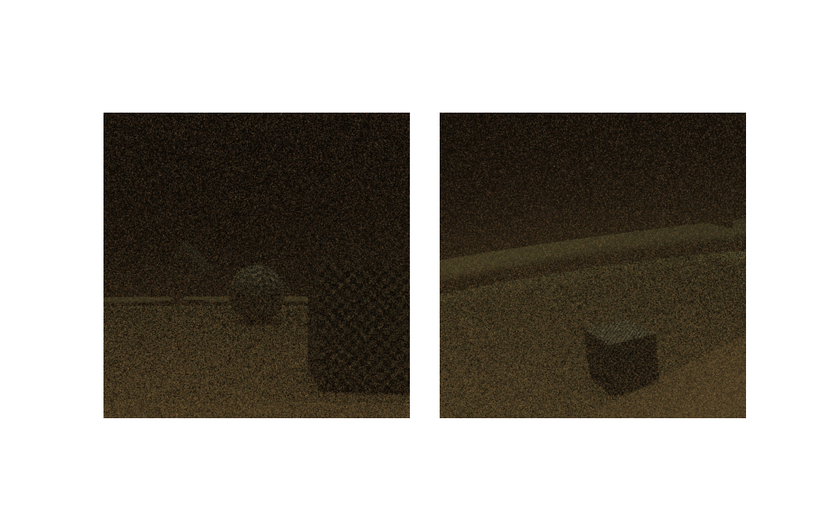
Challenges in Simulating Realistic Scene
Sensor is inside the medium
Sensor is just outside the medium

Slide 15






Simulations
$$σ_{S}=\left(0.2, 0.1, 0.1\right)$$
$$σ_{A}=(0.45, 0.06, 0.05)$$
$$σ_{S}=\left(0.7, 0.7, 0.7\right)$$
$$σ_{A}=(0.45, 0.06, 0.05)$$
$$σ_{S}=\left(0.4, 0.4, 0.4\right)$$
$$σ_{A}=(0.45, 0.06, 0.05)$$

Slide 16
Block Diagram
Mobile Phone
Raw image
Image pre-processing
Turbidity calculation
Logger
Web
Database
World wide measurements
Time, date, GPS location etc.
Other smartphone sensors
Other user’s smartphones/computers
UI

Slide 17
Milestones
so far:
Theoretical study
Chose optimal approach
Simulations
next:
Write and test the program
Mobile app
Targets kit

Slide 18
Timeline
NOV
DEC
JAN
FEB
(EXAMS)
MAR
APR
MAY
Research
Algorithm
Development
APP
Simulations
Measuring Kit
Approach Selecting
Adding Features

